Slide 1











Pharmaceutical Company
SALES
PERFORMANCE
& CUSTOMER SEGMENTATION
Analysis in Pharmaceutical Distribution
Tools :
You can Download
Dashboard PBI
Notebook Gcollabs

Slide 2

Agenda
01
06
Introduction
Excecutive Summary
02
07
Project Background
Customer & Distributor analysis
03
08
Objective Analysis
Sales Performance
04
09
Dataset
Customer Segmentation
05
10
Data Preparation
Conclution & Recomendation

Slide 3


I have a background in Geography with expertise in GIS Analysis and a strong interest in Data Science and Analytics. Skilled in Python, SQL, and data visualization, I aim to grow as a Data Scientist and deliver meaningful insights for data-driven decision making.
Highlights:
  Conducted geospatial data analysis and mapping for urban planning projects.
  Processed large geospatial datasets using ArcGIS & Python for 5+ projects.
  Delivered actionable insights to stakeholders, improving data reliability and efficiency.
Introduction
Pharmacy Company

Slide 4
Project background
In addition to sales analysis, pharmaceutical companies want to understand customer profiles:
  Customer segments with high revenue contribution
  Frequent, low-value customers
  One-time, high-value customers
Requirment
There are three levels of report users with different focuses:
  Executive Committee → sales overview (trends, city, channel, top product/city)
  Sales Manager → sales details (by distributor, product, top 5, distribution channel)
  Head of Sales → team performance (by product/class, sales ranking, period filter) or customer segmentation.
Pharmaceutical Company
This company sells drugs through distributors (not directly to consumers). Distributors are required to share their sales data so the company can analyze it down to the retail level.

Slide 5
Dataset
  Data from Kaggle
  Entries dirty = 254.082 rows 🡪 Entries clean = 251.445 rows
  Columns = 18 (original) 🡪 Columns = 22 (feature & engineered)
Objectives Analysis
  Analyze the company's sales performance.
  Identify top products, cities, distributors, and sales teams.
  Provide data-driven strategic insights.
  Add customer segmentation (K-Means) for more targeted marketing strategies.
Field | Description
Distributor | Name of the distributing company. In this dataset, consistently "Gottlieb-Cruickshank."
Customer Name | Name of the customer or purchasing entity.
City | The city in Poland where the customer is located.
Country | Country of the transaction, consistently "Poland."
Latitude | Latitude coordinate of the customer's city.
Longitude | Longitude coordinate of the customer's city.
Channel | Distribution channel, either "Hospital" or "Pharmacy."
Sub-channel | More specific buyer sector: "Private," "Retail," or "Institution."
Product Name | Name of the pharmaceutical product sold.
Product Class | Classification of the product (e.g., "Mood Stabilizers," "Antibiotics," "Analgesics.")
Quantity | Number of units sold.
Price | Price per unit of the product.
Sales | Total sales amount (Quantity × Price).
Month | Month of the transaction (all records = "January").
Year | Year of the transaction (all records = 2018).
Name of Sales Rep | Sales representative handling the transaction.
Manager | Manager overseeing the sales representative.
Sales Team | Sales team of the sales representative (e.g., "Delta," "Bravo," "Alfa.")

Slide 6
Feature Engineering
  Add Frequency column → number of transactions by customer
  Add Monetary column → total sales by customer
  Exp :
Data Preparation
Data Cleaning
  Check for missing values: No missing values
  Drop duplicate data: 4 data droped
  Validate data types
  Remove anomalous data (negative quantity). If it's still used, it can bias the analysis results. Approximately 2,633 rows were removed due to negative quantity.
index | Customer Name | Frequency | Monetary
0 | Abernathy Group | 346 | $24.902.609
1 | Abernathy Group Pharmaceutical Limited | 223 | $2.079.222
2 | Abernathy Group Pharmacy | 385 | $34.975.728
3 | Abernathy and Sons | 373 | $20.999.467
4 | Abernathy and Sons Pharmaceutical Limited | 390 | $18.860.508
Data Scaling
  Apply StandardScaler to Frequency & Monetary to balance the feature scales before clustering.

Slide 7
Excecutive Summary
Total Sales : $ 11,95 bn
Top Product Name
Top Product Class
Top City
Lonclotide
($ 169,08 M)
Analgesics
( $2.37 bn )
Butzbach
($93,56 M)
Top Country
Top Channel
Top Sub-Channel
Germany
($11,18 bn)
Pharmacy
($6,28 bn)
Retail
($3,34bn
The company's sales are heavily dependent on the Germany market, particularly through the pharmaceutical channel.
2018 saw a peak in sales, but the trend has since declined, necessitating a strategy to boost sales.
Channel and sub-channel diversification is crucial, as retail remains the primary backbone.
Notes:
$$$

Slide 8
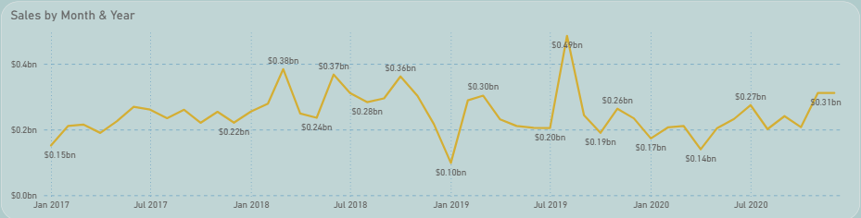
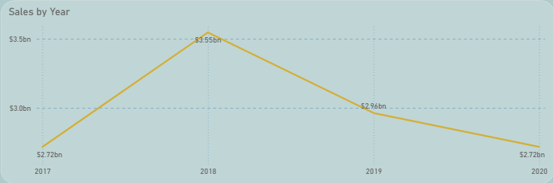
Revenue Growth
The company's revenue increased significantly in 2018, reaching $3.5 billion, the highest point during the analysis period.
There are seasonal fluctuations each year (sharp ups and downs).
Large spikes were seen in:
Early 2018 (possibly due to promotions/campaigns).
Late 2019 (possibly due to the holiday season/seasonal demand).
There was a sharp drop in mid-2019 → the causes of this can be traced (supply, demand, sales strategy, etc.).
Notes:
$$$

Slide 9
Distributor & customer analysis
Sales details by Gerlach LLC
Sales details by Mraz-Kutch Pharma
Product Class | Sales | %
Antiseptics | $695.505.571 | 19,64%
Analgesics | $656.019.067 | 18,52%
Mood Stabilzers | $618.002.495 | 17,45%
Antipiretics | $594.669.486 | 16,79%
Antibiotic | $537.916.947 | 15,19%
Antimalarial | $439.583.742 | 12,41%
Total Sales | $3.541.697.308 | 100,00%
The company relies heavily on a few key distributors (primarily Gerlach LLC).
Top-spending customers like Mraz-Kutch Pharma are key to growth.
Its flagship product category is antiseptics and analgesics by distributor Gerlach LLC
Product Class | Sales | %
Analgesics | 80791299 | 85,07%
Antibiotic | 5933665 | 6,25%
Antimalarial | 1052309 | 1,11%
Antipiretics | 2033785 | 2,14%
Antiseptics | 3078512 | 3,24%
Mood Stabilzers | 2078346 | 2,19%
Total Sales | 94967916 | 100,00%
Notes:
$$$

Slide 10
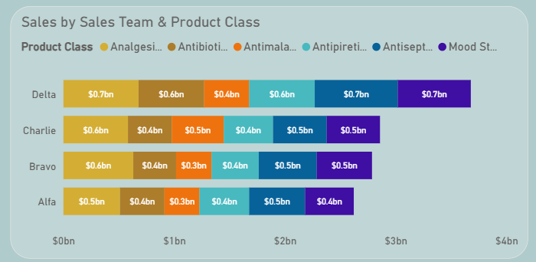
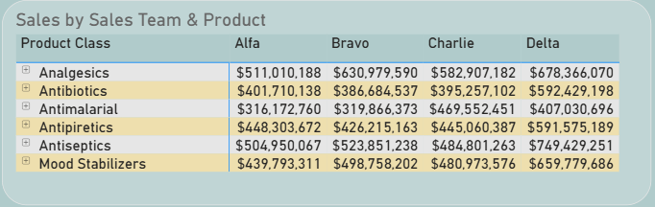
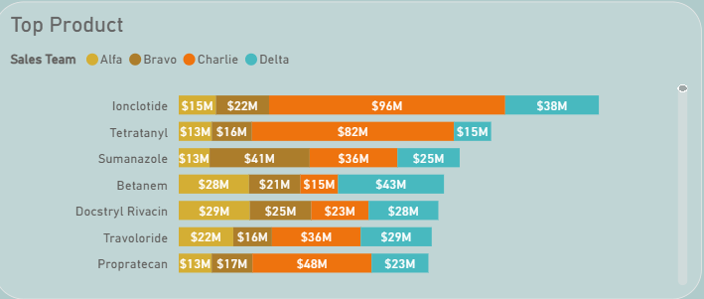
Sales Team Performance
Top Manager
Top Sales Rep
Britanny Bold from Delta Team
($3,67bn)
Jimmy Grey from Charlie Team
($0,99bn)
The Delta Team is the company's main sales backbone → requires continued motivation and support.
Jimmy Grey, as the best sales representative, can serve as a role model/trainer to improve the performance of other teams.
Ionclotide is a best-seller → the pricing and distribution strategies for this product must be optimized.
Bravo and Alfa are still lagging behind → require special programs such as training, incentives, or marketing support.
Notes:
$$$

Slide 11
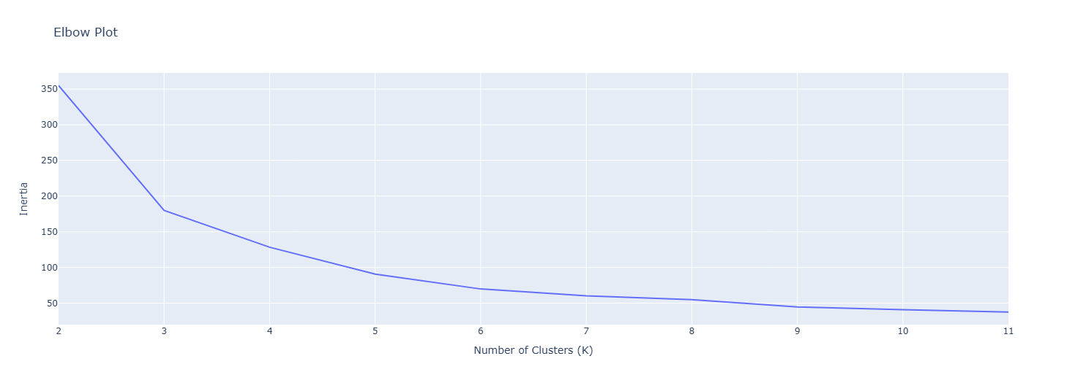
Customer Segmentation
K-means Clustering analysis
Create an Elbow Plot on the K-Means Clustering method
for helps determine the optimal number of clusters by finding the “elbow” point

Slide 12
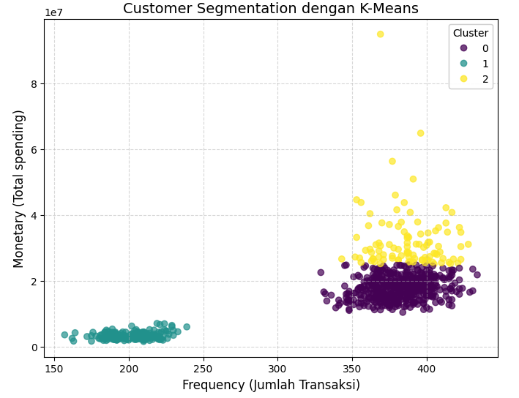
Scatter plot :
Customer segmentation by frequency and monetary (K-mean)
From the previous elbow plot analysis, 3 clusters were obtained,
namely clusters 0, 1 and 2.
Exp table :
index | Customer Name | Frequency | Monetary | Cluster
0 | Abernathy Group | 346 | $24.902.609 | 0
1 | Abernathy Group Pharmaceutical Limited | 223 | $2.079.222 | 1
2 | Abernathy Group Pharmacy | 385 | 34.975.728 | 2
3 | Abernathy and Sons | 373 | $20.999.467 | 0
4 | Abernathy and Sons Pharmaceutical Limited | 390 | $18.860.508 | 0
One point (dot) on the graph represents one customer.
So, if there is a dot on the top right, it means that the customer buys frequently (high frequency) and with a large transaction value (high monetary).

Slide 13
Customer Segmentation
Cluster 2 (VIP / High Value Customers)
The smallest number of customers (99 customers).
Total revenue is quite large ($3.2 billion).
The highest average monetary value per customer ($32.32 million). 👉 Characteristics: Few customers but very valuable because their average spending is higher than others.
Cluster 0 (Mass Customers, Mid Value)
Largest number of customers (452 ​​customers).
Largest revenue ($8.05 billion) due to high customer base.
Average Monetary per customer is still moderate ($17.86 million). 👉 Characteristics: Many customers with moderate contribution.
Cluster 1 (Low Value Customers)
Decent customer base (200 customers).
Revenue is relatively small ($0.68 billion).
Lowest average monetary ($3.24 million).
👉 Characteristics: low-value customers, possibly disloyal/low volume.
Notes:
$$$

Slide 14
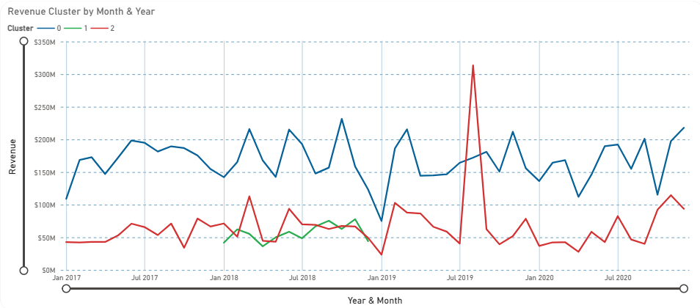
Cluster | Customer Count | Avg Frequency | Avg Monetary | Total Revenue
0 | 452 | 381.79 | $17.830.673 | $8.059.464.442
1 | 200 | 202.32 | $3.405.283 | $681.056.671
2 | 99 | 387.99 | $32.373.092 | $3.204.936.177
Customer Segmentation – Insight
Cluster 0 → consistently contributes the largest revenue, with an upward trend after 2020. This indicates they are backbone customers.
Cluster 1 → contributes the smallest amount, tends to be flat and shows no significant growth. They are considered low-value customers.
Cluster 2 → despite having fewer customers, contributes significantly to revenue, even experiencing a sharp spike in mid-2019. It has high potential, but is also more volatile.
Trend Line sales Cluster by month & year

Slide 15
Recommendations
Conclusions
  ⭐ Retain VIP Customers (Clusters 0 & 2): loyalty programs & premium service.
  🔄 Re-engage Cluster 1: targeted promos, digital campaigns, trial offers.
  🌍 Diversify products & markets: reduce stagnation risk.
  📉 Revenue declining since 2018 → needs action.
  🏥 Highly dependent on VIP customers → concentration risk.
  👥 Cluster 0 & 2 dominate, Cluster 1 adds little value.

Slide 16
Pharmaceutical Company
Thank You

Slide 17
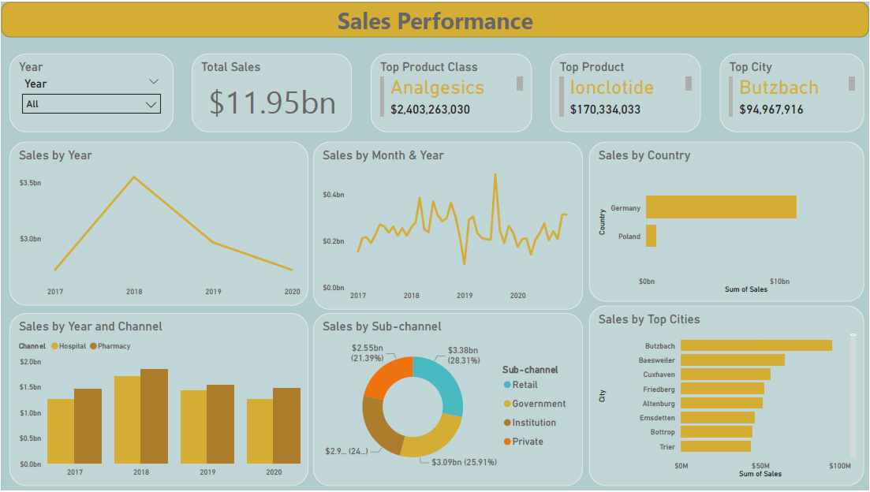

Slide 18
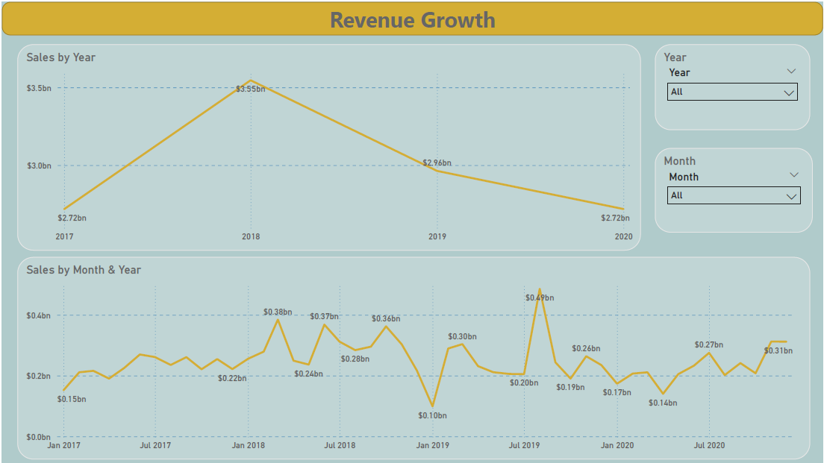

Slide 19
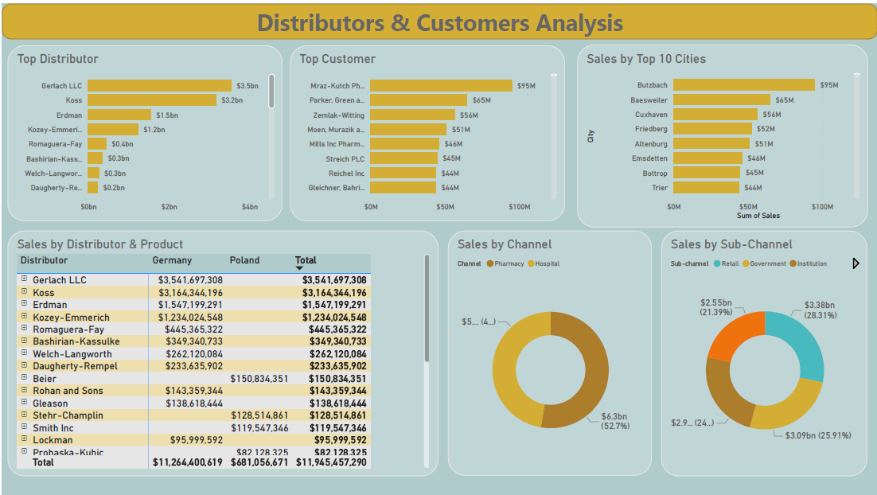

Slide 20
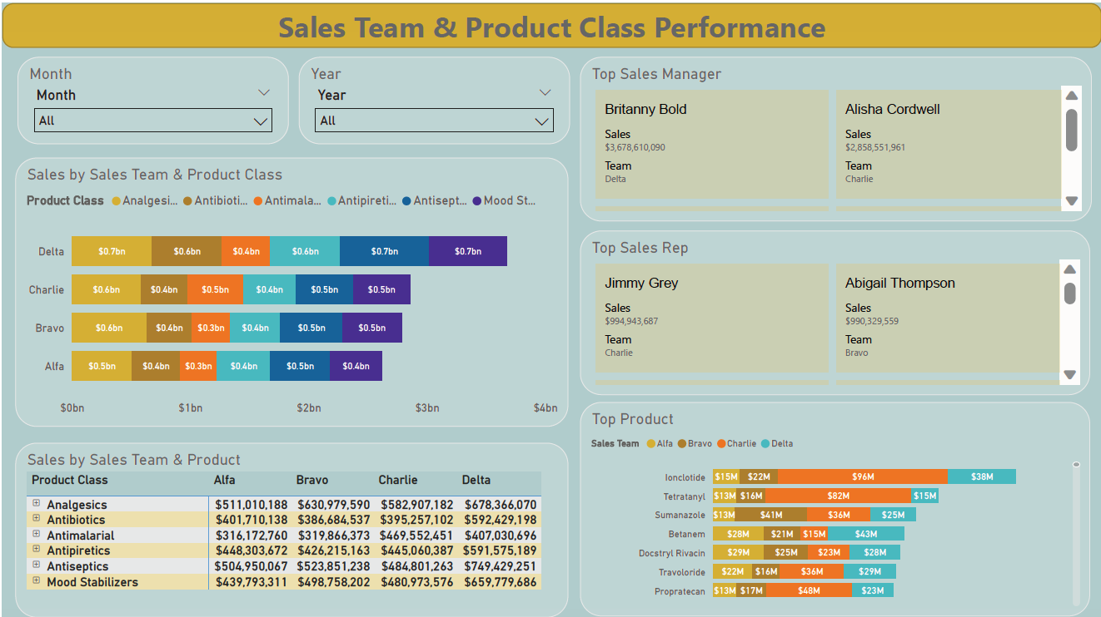

Slide 21
